Slide 1
The Utilization of (Re)Writing in Death at Solstice and Black Widow’s Wardrobe by Lucha Corpi
Guadalupe Garcia and Kasandra Moreno
Spring 2020
Advisor: Dr. Carolyn González

Slide 2
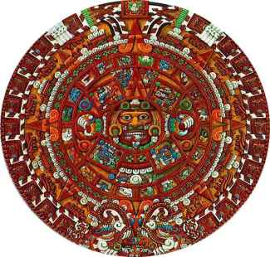
Agenda
Inspiration for the project
Purpose of the investigation
Research questions
Biography-Lucha Corpi
The Novels
Black Widow’s Wardrobe(1999)
Death at Solstice(2009)
Literature Review
Historical Review
Comparison
Death at Solstice vs. Black Widow’s Wardrobe
The representation of (re)writing in the novels
Analysis
Conclusion
Bibliography

Slide 3
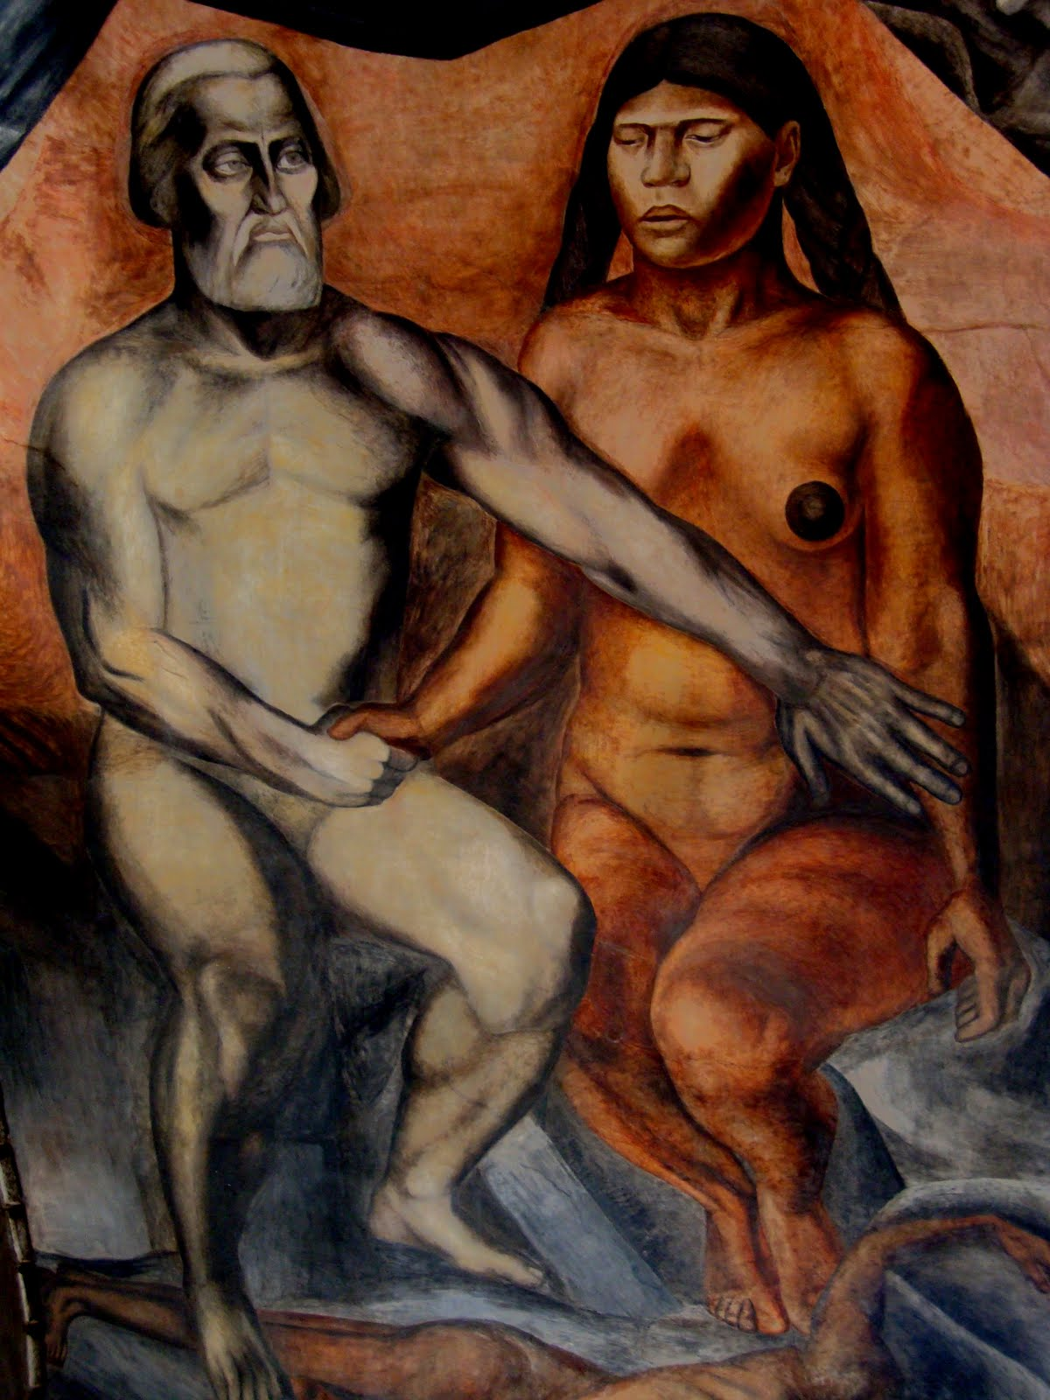
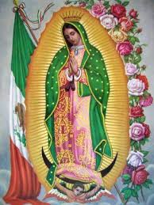
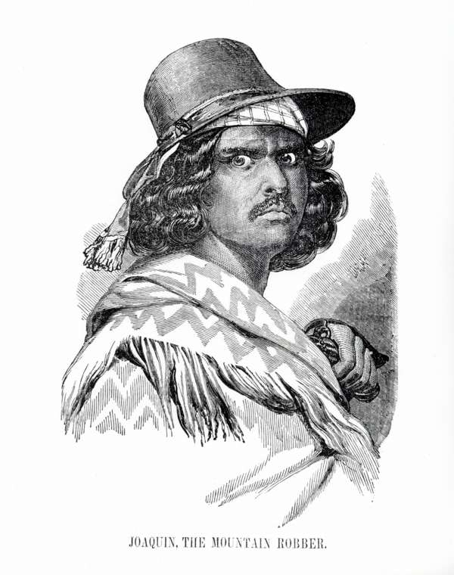
Inspiration for the Project
Wanted to further study a topic related to Chicana literature, specifically one focused on the (re)writing of Mexican historical and cultural figures
Wanted to know why Lucha Corpi decided to use (re)writing, specifically in her works of fiction (mystery novels)

Slide 4
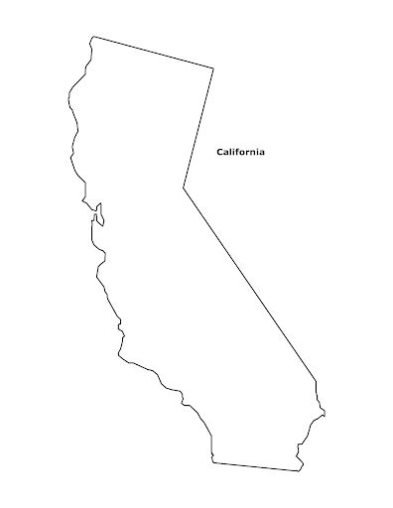
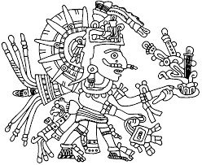
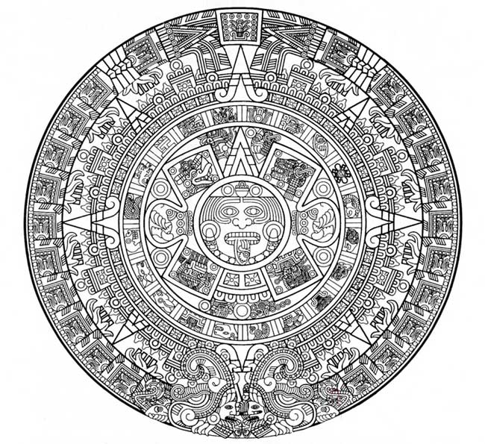
Purpose of the Investigation
The purpose of our project is to investigate and identify the significance of (re)writing in the two novels (Death at Solstice and Black Widow’ Wardrobe) and why it was essential for Lucha Corpi to incorporate this technique and the historical figures of the Virgin Mary, “La Malinche”, and Joaquín Murrieta in her works of detective fiction
Notes:
Lupita

Slide 5
Research Questions
Why does Lucha Corpi use (re)writing in her two works of detective fiction, Death at Solstice and Black Widow’s Wardrobe ?
What effect does the use of (re)writing have on her work, as well as on Chicanx detective fiction in general?
Notes:
Lupita

Slide 6
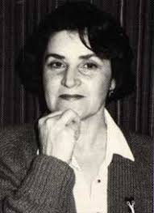
Biography-Lucha Corpi
April 13 1945
Jaltipan, Veracruz, Mexico
Migrated in 1964
Known as a Chicana poet and writer of murder mysteries
Her works vary from children’s literature to poetry and mysteries
B.A. from UC Berkeley
M.A. from SFSU

Slide 7
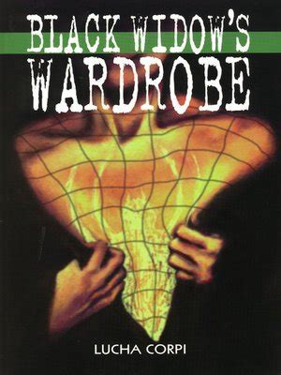
Black Widow’s Wardrobe(1999)
Characters
Gloria Damasco- Detective
Licia - “La Malinche,” Black Widow
Location
City of San Francisco
Sierra de Tepoztlan
Summary
The Chicana detective Gloria Damasco decides to participate in the Day of the Dead celebration in San Francisco, where she witnesses the attempted murder of a woman recently released from prison, known as the Black Widow. In the process of discovering the reason for her attack, Gloria has to immerse herself in the story of the Black Widow.

Slide 8
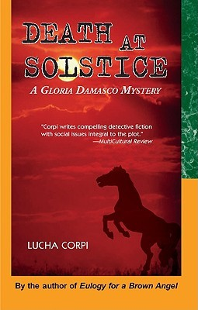
Death at Solstice(2009)
Characters
Gloria Damasco-Detective
Virginia Moreno-“The Saint”
Joaquín Murieta-Bandit
Location
Legendary Gold Country
Summary
The Chicana detective, Gloria Damasco, is in charge of investigating the theft of very valuable jewelry. However, everything begins to get worse when mysterious accidents occur. These include the murder of a nurse, the kidnapping of a woman who is considered a “saint,” and the presence of the ghost of a horse that presumably belongs to Joaquin Murrieta.
Notes:
Lupita

Slide 9
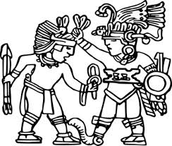
Literature Review
Chicana Feminist Literature
Writing and (Re)Writing
The Tradition of Murder Mystery Writing
Chicano Murder Mysteries
Historical Context
Main Themes
Examples
Notes:
Lupita

Slide 10
Chicana Feminist Literature
Historical Context:
The Chicana movement was a movement within the greater Chicano movement that emerged in the 1960s
The Chicana movement occurred when women in the movement began to notice that their needs and voices were not heard within the dominant male ideology
Main Themes:
Gender role of a woman
Redefining the meaning of being a woman
Changing the way women are seen in society
Examples:
Across a Hundred Mountains (2006) - Reyna Grande
Borderlands/La Frontera (1987) - Gloria Anzaldúa

Slide 11
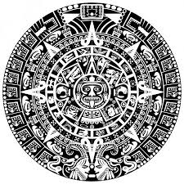
Writing and (Re)writing
Historical Context:
Began during the Chicana movement in the 1960s
It is a technique used by Chicana writers
Rectifies history, adds complexity, or is used to redeem historical figures who have traditionally been judged unfairly or simplistically
Main Themes:
Religion
Feminism
The change of archetypes of women
Examples:
“Guadalupe the Sex Goddess” (1996) - Sandra Cisneros
Woman Hollering Creek(1991) - Sandra Cisneros
Notes:
Lupita

Slide 12
Tradition of Murder Mysteries
Historical Context:
Introduced in the 18th century
Began when the prison of Newgate in London was authorized to publish the stories of notorious criminals
The first type of murder mystery were gothic novels
From there, the golden age of writing murder mysteries began
Main Themes:
Focuses attention on examining evidence
Murder
Committed crime
The process of the detective’s work
Examples:
“The Tell-Tale Heart” (1843)- Edgar Allan Poe
“Death and the Compass” (1942) - Jorge Luis Borges

Slide 13
Chicano Murder Mysteries
Example:
“Down a dark tunnel, I run after someone, but I can’t tell who. A man’s hand emerges from the darkness, the long, thin fingers and thumb wrapped around the stock of a pistol. An elegant hand. How can such a beautiful hand, more suited for the piano or the guitar, wield an instrument of death? The hand retreats back into the darkness. “Why did you take him from me?” questions a raspy voice-I cannot tell if man or woman. Suddenly I am pursuing the acrobat up a long staircase. A sharp pain stabs at my belly. I fall on my knees, gasping for breath.”
Black Widow’s Wardrobe (pg.44)
Notes:
Lupita

Slide 14
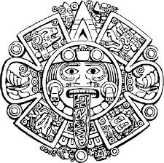
Historical Review
The Virgin Mary
La Malinche/ The Damned One
Joaquin Murrieta
History or Biography
Incorporation within the novels Death at Solstice or Black Widow’s Wardrobe

Slide 15
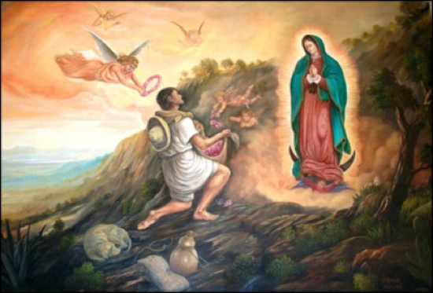
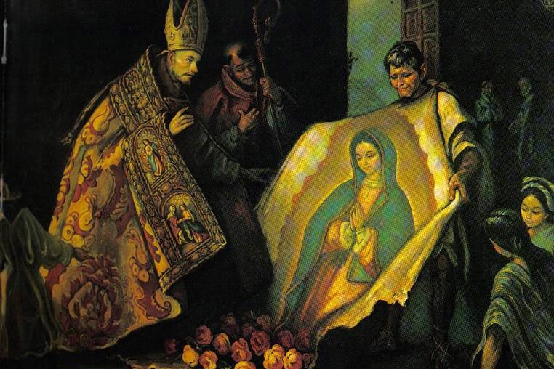
Virgin of Guadalupe
History:
On December 9, 1531, Our Lady of Guadalupe is said to have appeared to Juan Diego Cuauhtlatoatzin for the first time on the Tepeyac hill
On December 12, 1531, "The Guadalupan Event" occurred and Juan Diego showed the Spaniards that the apparition was true
Incorporation:
La Virgen is incorporated into the story in Death at Solstice through the character of Virginia Moreno who is known as "La Santa"
Notes:
Do you think there is another purpose to incorporating Virginia/La Virgen beyond the importance of religion in our culture? Thinking back to Guadalupe the Sex Goddess, how is Virginia a rewriting of this figure? How is she (and not) like the traditional virgin? What is Corpi trying to accomplish including her represented in this way? How is she a key to
Lupita

Slide 16
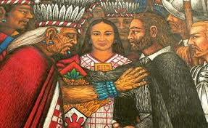
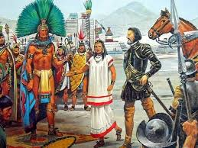
La Malinche
History:
She was born in 1500 and died before 1529
She was a slave before she was ‘gifted’ to Hernan Cortes and worked as an translator, advisor and concubine
The way that she is viewed by others has changed due to the evolving social perspective and politics of Mexico
Incorporation:
She is incorporated within the story of Black Widow’s Wardrobe through the character of Licia Roman Lecuona, who believes she is the reincarnation of “La Malinche”

Slide 17
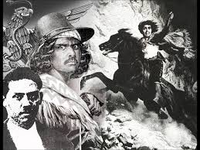
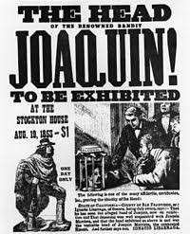
Joaquin Murrieta
History:
It is assumed that he was born in Sonora, Mexico around 1830
He was about 18 years old when he arrived to California with his wife, Rosa Feliz
He rewarded people who offered him shelter and helped him keep his identity a secret, which is how he acquired the reputation of “Robin Hood del Dorado”
Incorporation:
The ghost of a horse represents the bandit, Joaquin Murrieta, within the story of Death at Solstice
Notes:
Lupita

Slide 18
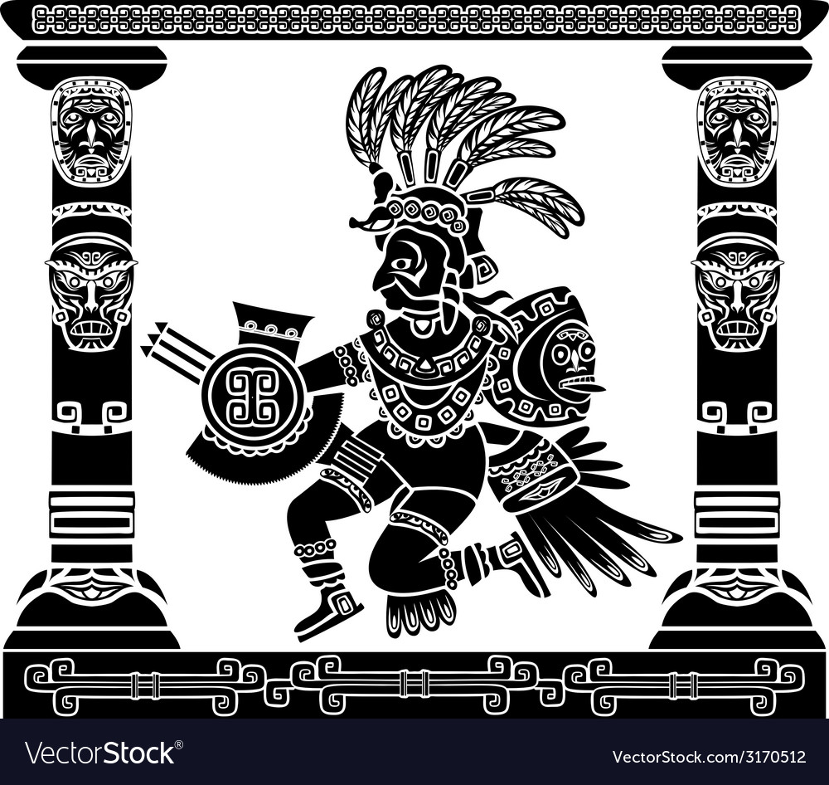
Comparison of the Novels
Death at Solstice
Virginia Moreno is known as “La Santa” by the people that surround her and that is the reason why she is kidnapped
Ex: “She grants miracles with the help of the Lord and His Blessed Mother. Thank the Lord Jesus, I’m in good health. But people swear all she has to do is look at them or touch them and they’re cured.” (Death at Solstice 38)
Black Widow’s Wardrobe
Licia Roman Lecuona is known as the “Black Widow,” who believes that she is the reincarnation of La Malinche
Ex: “As for me , I’ll be going back to the place where I was born, to complete the cycle that began on my birth nearly five hundred years ago…” “It’s signed ‘Malintzin Tenepal,” Justin added. (Black Widow’s Wardrobe 189-190)
Notes:
Not for the PowerPoint but a thought for the paper- do these rewritings help break with the Virgin/ whore dichotomy? (Humanizing both Malinche and Guadalupe- even though Guadalupe keeps a little of her magic.)

Slide 19
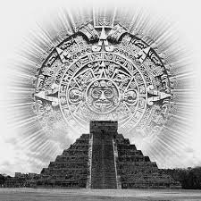
Analysis of the Novels
Black Widow’s Wardrobe
The (re)writing of La Malinche helps the detective, Gloria Damasco, solve the mystery
Through the novel, the reader learns about the history of this cultural and historical figure and how it relates to the main character Licia Roman Lecuona

Slide 20
Analysis of the Novels (cont.)
Death at Solstice
The (re) writing of La Virgen de Guadalupe is integrated into this novel to demonstrate how she is admired and honored in Mexican culture
Virginia's character is considered a piece of the puzzle in order to find her nurse's killer
Notes:
Lupita

Slide 21
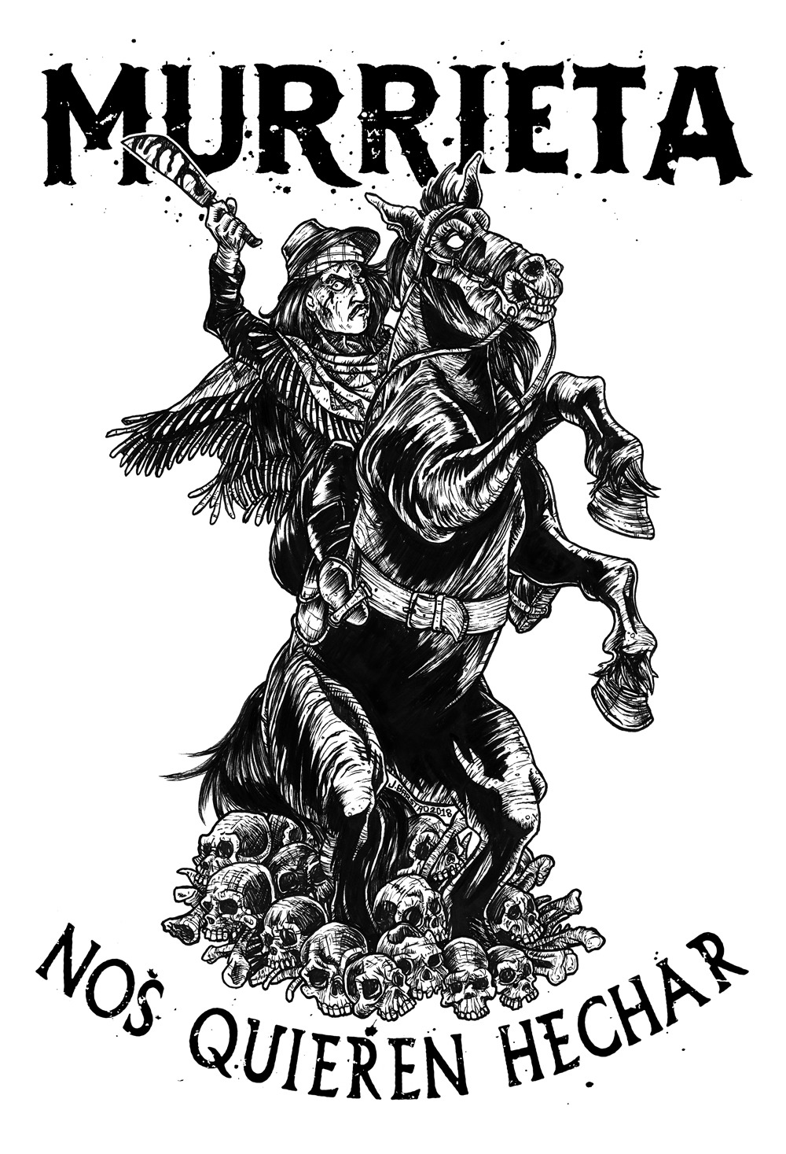
Incorporation of Joaquin Murrieta
According to one version of the legend of El Zorro, he is the protector of those who can’t or don’t know how to defend themselves
Joaquin Murrieta is thought of as taking the identity of El Zorro, the man
Joaquin was also part of the California Gold Rush, a historical event that helped California become a state
He appears in Gloria Damasco’s dreams and is also represented by the ghost of a horse
Notes:
Interviewee Last, First M. “Interview Title.” Interview by First M. Last. Magazine Name Date Month Year: Page(s).
But how is this legend represented in Death at Solstice? Why is it by a woman? How does she restore justice?
I would continue work on this slide to focus on what is unique about Juaquin Murieta in the novel itself
Lupita

Slide 22
Conclusion
Black Widow’s Wardrobe
Licia's life is connected to La Malinche's life to discover the similarities between the two but also to show how different they are due to contemporary times
Death at Solstice
The representation of the Virgin of Guadalupe and the character of Virginia Moreno "La Santa" prove the importance of religion within the Chicanx culture
The effect of (re) writing is used to help integrate culture with detective fiction to raise the intensity and mystery of the cases in both stories, along with challenging the archetypes of women and the way they are seen
Notes:
So you don't believe she is actually the reincarnation of La Maliche? Or is she a reincarnation who is able to be different because contemporary times have allowed her to be (whereas the original Malinche really had no choice)- clarify
I would still encourage you to consider why Virginia is the key to solving the mystery. Is there also a key message related to her that we should get from the text?

Slide 23
Thank you!
Dr. Carolyn González, classmates of WLC Capstone, WLC faculty

Slide 24
Special thanks to
Lucha Corpi

Slide 25
Bibliography
Alarcon, Norma. “Traddutora, Traditora: A Paradigmatic Figure of Chicana Feminism.” Cultural Critique, no. 13, 1989, pp. 57–87.
Rebolledo, Tey Diana, and Eliana S. Rivero. Infinite Divisions: An Anthology of Chicana Literature. Tucson: U of Arizona, 1993. Print.
Ruiz, Sandra, et al. Escrito Con Tinta Roja: The Mexicana Feminist Detective in the Fiction of María Elvira Bermúdez, Myriam Laurini and Patricia Valladares, 2014, pp. ProQuest Dissertations and Theses.
Maloof, Judy. The Chicana Detective as Clairvoyant in Lucha Corpi’s Eulogy for a Brown Angel(1992), Cactus Blood(1996), and Black Widow’s Wardrobe(1999). The University of New Mexico, 2006. pp. 92-112.
Rodriguez, Ralph E.. Brown Gumshoes : Detective Fiction and the Search for Chicana/o Identity, University of Texas Press, 2005. ProQuest Ebook Central
Bost, Aparicio, Bost, Suzanne, and Aparicio, Frances R. The Routledge Companion to Latino/a Literature. New York: Routledge, 2012. Routledge Companions. Web.

Slide 26
Bibliography
Blackwell, Maylei. Chicana Power!: Contested Histories of Feminism in the Chicano Movement. 1st ed., University of Texas Press, 2011.
Saldívar-Hull, Sonia. Feminism on the Border: Chicana Gender Politics and Literature. Berkeley: U of California, 2000. Print.
Gomez, Susan, Rocco, Raymond, and Saldivar-Hull, Sonia. Contemporary Chicana Feminist Discourse: Negotiating the Boundaries, Borders and “Brujos” among and between Critical Counter Discourses (2003): ProQuest Dissertations and Theses. Web.
Moraga Cherríe, Anzaldua Gloria, and Bambara Toni Cade . This Bridge Called My Back: Writings by Radical Women of Color. Second ed. New York: Kitchen Table, Women of Color, 1983. Print.
Rodriguez, Ralph, and Limon, Jose. Chicana and Chicano Fiction into the Nineties: Genre and Contestation, 1997, pp. ProQuest Dissertations and Theses.
Borges, Jorge Luis. La Muerte Y La Brújula: [cuentos]. Buenos Aires: Emecé Editores, 1951. Print. Novelistas Argentinos Contemporáneos

Slide 27
Bibliography
Malmgren, Carl D. “Anatomy of Murder: Mystery, Detective, and Crime Fiction.” Journal of Popular Culture, vol. 30, no. 4, 1997, pp. 115–135.
Poe, Edgar Allan. The Tell-Tale Heart. Project Gutenberg ; NetLibrary, 2000
Corpi, Lucha. Death at Solstice. Houston: Arte Publico Press, 2009. U.S.A
Corpi, Lucha. Black Widow's Wardrobe. Arte Público, 1999.
Nelson, Patricia, "Rewriting Myth: New Interpretations of La Malinche, La Llorona, and La Virgen de Guadalupe in Chicana Feminist Literature" (2008). Undergraduate Honors Thesis. Paper 788.
Cypess, Sandra Messinger. La Malinche in Mexican Literature: from History to Myth. University of Texas, 1991
Paz, Ireneo. Life and Adventures of the Celebrated Bandit Joáquin Murrieta, Arte Público Press, 1999. ProQuest Ebook Central.
Colby, Jennifer. "Transforming Tonantzin/Guadalupe: Women's Art and Dialogue in Central California." Femspec 19.1 (2019): 33-149. Web.

Slide 28
Bibliography
Chávez, Eduardo. Our Lady of Guadalupe and Saint Juan Diego : The Historical Evidence. Rowman & Littlefield Publishers, 2006.
Valenzuela , Aida. “Lucha Corpi: Mystery, Evolution and the Nth Generation in Chicana/o Identity via the Gloria Damasco Detective Series .” Purdue University , 2011.
Paz, Octavio. El Laberinto De La Soledad. New York, N.Y.: Penguin, 1997. Print. Penguin Ediciones.
Corpi, Lucha. “Interview Questions:Black Widow’s Wardrobe & Death at Solstice.” Interview by Guadalupe Garcia, Kasandra Moreno-Diaz, Carolyn Gonzalez. Capstone Project May 6 2020: Pages 1-5.

